Slide 1



Maven Overview

Slide 2
You will learn how to …
Create Maven projects with Eclipse
Add dependencies to Maven pom.xml file
Build and run Maven projects
www.luv2code.com

Slide 3
Practical Results
Cover the most common Maven tasks that you will need on daily projects
•
Not an A to Z reference … for that you can see Maven Reference Manual
•
But don’t worry, I will give you links to
•
Maven Reference Manual
www.luv2code.com

Slide 4
Free Maven Resources
Maven Reference Manual
www.luv2code.com/mavenreferencemanual
www.luv2code.com

Slide 5
What is Maven?
•
Maven is a Project Management tool
•
Most popular use of Maven is for build management and dependencies
www.luv2code.com

Slide 6
What Problems Does Maven Solve?
•
When building your Java project, you may need additional JAR files
•
For example: Spring, Hibernate, Commons Logging, JSON etc…
•
One approach is to download the JAR files from each project web site
•
Manually add the JAR files to your build path / classpath
www.luv2code.com

Slide 7









My Project without Maven
My Super Cool App
Spring JAR files
Spring Hibernate
Commons Logging
JSON
…
Hibernate JAR files
developer
Apache Commons JAR files
JSON JAR files
www.luv2code.com

Slide 8
Maven Solution
Tell Maven the projects you are working with (dependencies)
Spring, Hibernate etc ….
•
Maven will go out and download the JAR files for those projects for you
•
And Maven will make those JAR files available during compile/run
•
Think of Maven as your friendly helper / personal shopper :-)
www.luv2code.com

Slide 9

My Project with Maven
Maven Central Repository (remote)
My Super Cool App
Spring JAR files
Hibernate JAR files
Spring Hibernate
Commons Logging
JSON
…
developer
Maven
Apache Commons JAR files
JSON JAR files
www.luv2code.com

Slide 10








Maven - How It Works
Maven Local Repository
Check local repo
(your computer)
Project Config file
2
Spring Hibernate
Commons Logging
JSON
…
developer
Read config file
4
Save in local repo
1
Maven
Maven Central Repository (remote)
5
Build and Run
3
Get from remote repo
www.luv2code.com

Slide 11
Handling JAR Dependencies
•
When Maven retrieves a project dependency
•
It will also download supporting dependencies
•
For example: Spring depends on commons-logging …
•
Maven will handle this for us automagically
www.luv2code.com

Slide 12
Building and Running
•
When you build and run your app …
•
Maven will handle class / build path for you
•
Based on config file, Maven will add JAR files accordingly
www.luv2code.com

Slide 13
Standard Directory Structure
•
Normally when you join a new project
•
Each development team dreams up their own directory structure
•
Not ideal for new comers and not standardized
•
Maven solves this problem by providing a standard directory structure
www.luv2code.com

Slide 14

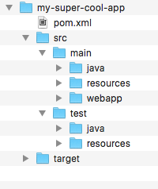
Standard Directory Structure
Directory | Description
src/main/java | Your Java source code
src/main/resources | Properties / config files used by your app
src/main/webapp | JSP files and web config files other web assets (images, css, js, etc)
src/test | Unit testing code and properties
target | Destination directory for compiled code. Automatically created by Maven
www.luv2code.com

Slide 15

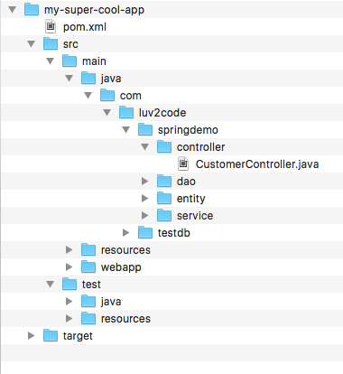



Standard Directory Structure
Place your Java source code here
www.luv2code.com

Slide 16

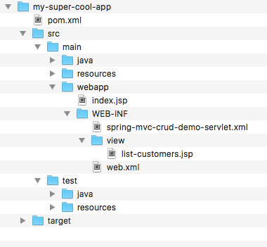



Standard Directory Structure
Place your Web assets here
www.luv2code.com

Slide 17

Standard Directory Structure Benefits
•
For new developers joining a project
•
They can easily find code, properties files, unit tests, web files etc …
www.luv2code.com

Slide 18
Standard Directory Structure Benefits
Most major IDEs have built-in support for Maven
Eclipse, IntelliJ, NetBeans etc
IDEs can easily read/import Maven projects
•
Maven projects are portable
Developers can easily share projects between IDEs
No need to fight about which IDE is the best LOL!
www.luv2code.com

Slide 19
Advantages of Maven
Dependency Management
Maven will find JAR files for you
No more missing JARs
•
Building and Running your Project
No more build path / classpath issues
•
Standard directory structure
www.luv2code.com

Slide 20
My Personal Best Maven Benefit(s)
•
Once you learn Maven, you can join a new project and be productive
•
You can build and run a project with minimal local configuration
www.luv2code.com

